Slide 1
Adventure Sales and Customer insights dashboard .
Analyzing product Analyzing product sales, customer behavior and regional performance across time Analyzing product sales, customer behavior and regional performance across time sales customer behavior Analyzing product sales, customer behavior and regional performance across time
And regional performance across time
-Sonali Pawar

Slide 2
Objective:
To analyze Total orders, revenue, profit, return rates, and customer behavior across categories , time periods, and regions to identify performance trends and customer segments.
To monitor sales performance and identify trends across different product categories and time period.
To evaluate the effectiveness of current sales strategies using KPIs like total orders, revenue, profit, and return rate.
To segment customers based on income and education levels for targated marketing and engagement.
To analyze regional sales distribution and identify high performing countries and continents

Slide 3
Data Overview
This dataset contains multiple tables and connection between them.
Dataset highlights
Revenue – 2.91M
Profit – 10.46
Total orders – 25K
Return rate – 2.17
Key Fields
This is too large dataset but the following are some key fields
Order date and Transaction date, Product name, Product category, Quantity sold, Unit price, Total revenue, total order, customer name, Gender, Country, continent etc……..

Slide 4
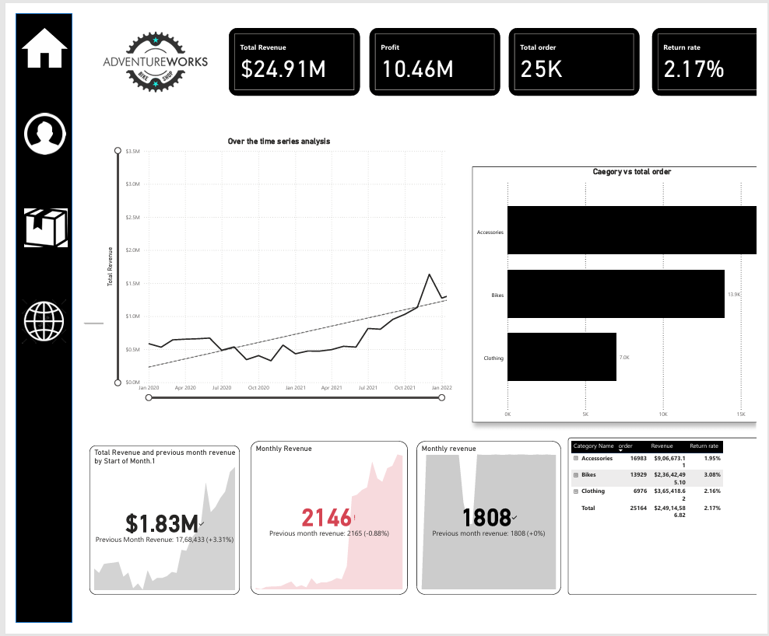
Sales Overview Dashboard

Slide 5
Dashboard structure
To provide a high-level overview business performance through total orders, revenue, profit, and return metrics – along with category –specific performance and time based trends
Key Elements
KPI Cards :Total Revenue, profit, Total order, return rate
Product Categories: Accessaries, Bike, Clothing….
Trends: Over the time Revenue analysis, Product category-wise Total Revenue Comparison
Demographics & usage analysis: Compare the total revenue by setting previous month revenue and set a target value to analyse profit and loss.

Slide 6
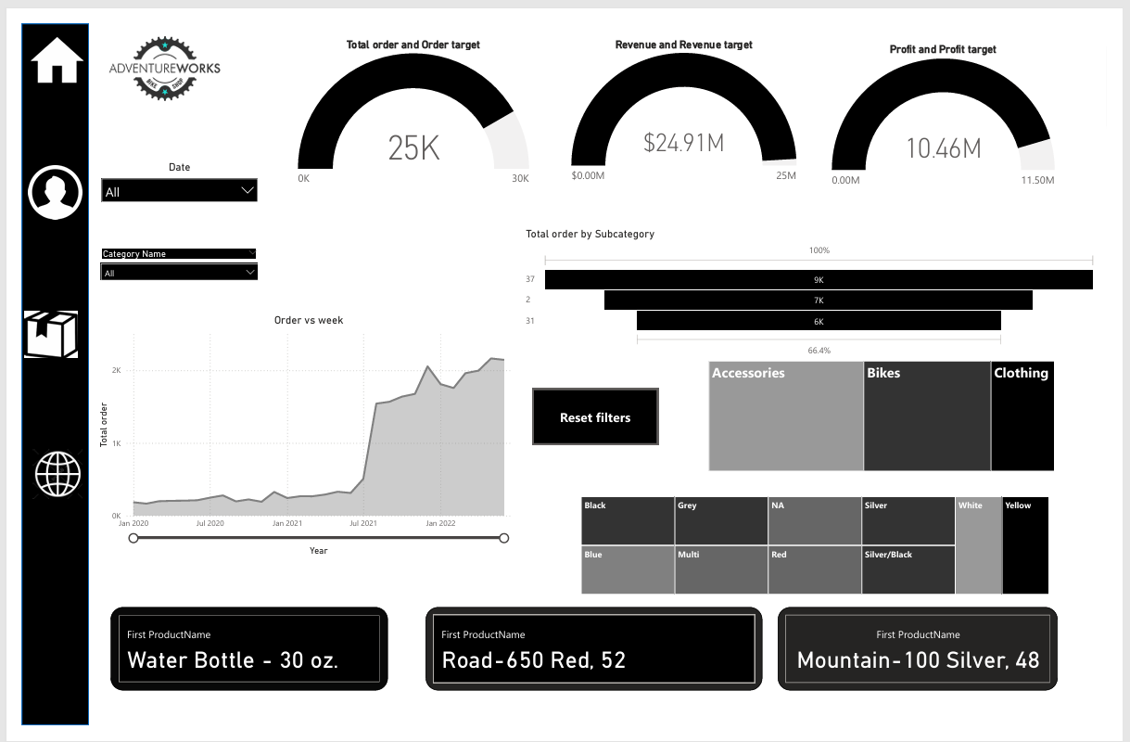
Product Target & Performance Dashboard

Slide 7
Dashboard Structure
To evaluate business performance against defined targets for orders, revenue, and profit, using gauge charts for visual tracking and to identify gaps in performance
Key Elements
Gauge charts :Total orders vs order target, Total Revenue vs Revenue target, Total profit vs profit target
Line Chart: Total Orders over Time
Apply Slicers to Product color, category name
Use Funnel to Total order by subcategory.
Use Area chart to order vs week

Slide 8
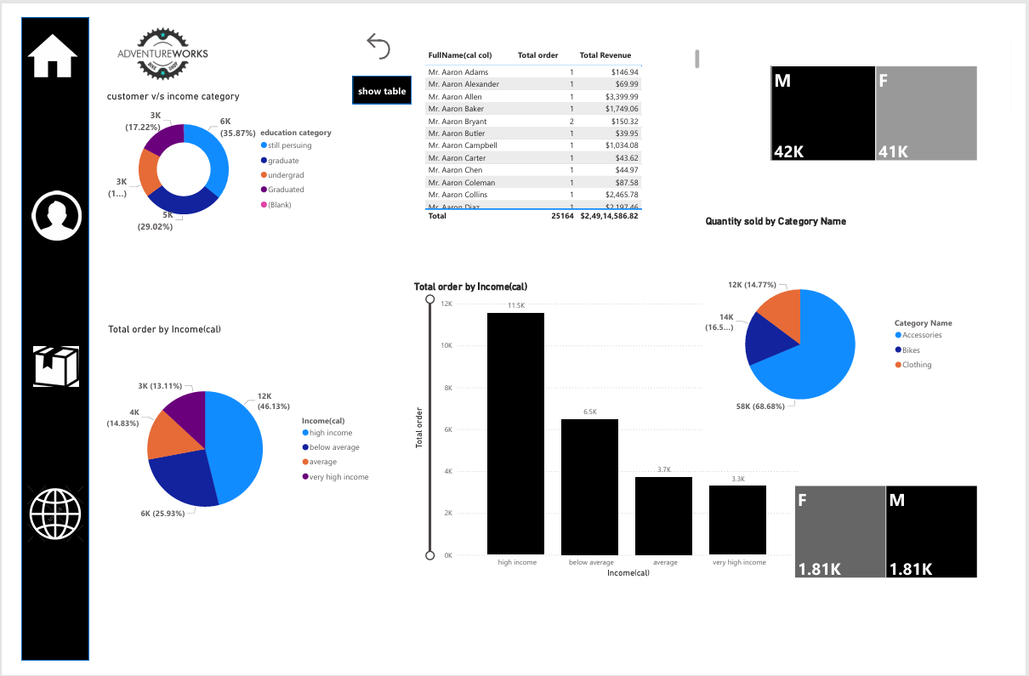
Customer Demographics Dashboard

Slide 9
Dashboard Structure
To understand the customer base by analyzing demographic factors such as income level, education status, and gender enabling better customer segmentation and targeted marketing strategies.
Bar chart : Total orders by income category
X axis: income categories
High income(11.5K)
Below Average(6.5K)
Average(3.7K)
very high income(3.3K)
Y-axis : Total orders

Slide 10
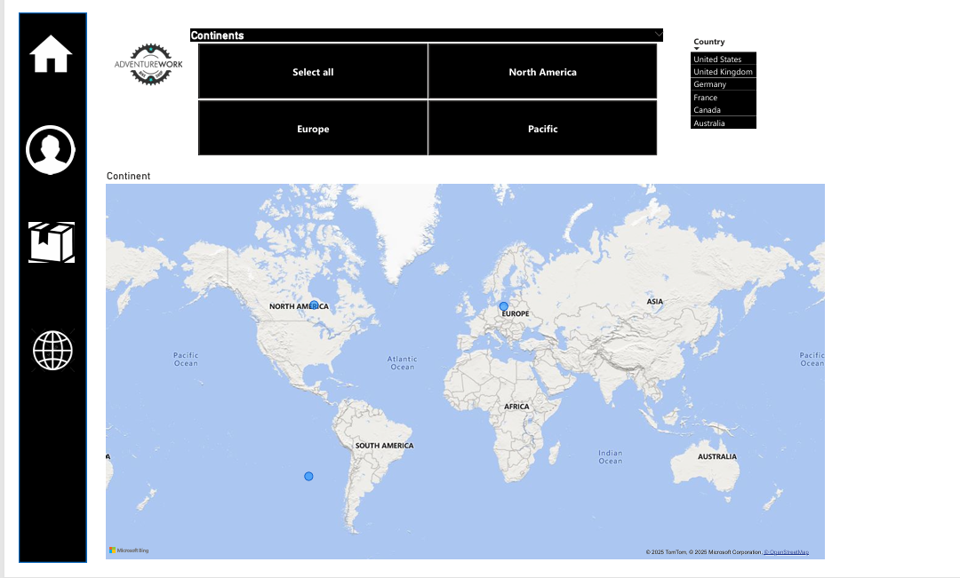
Continent-wise Map

Slide 11
Dashboard Structure
To analyze how sales are distributed across different countries and continents, helping the business identity high-performing regions and explore market expansion opportunities.
Top countries displayed:
United States, United Kingdom, Germany, France, canada, Australia.
Geographical Layers: Continents(filter), Countries shown on map.
Filter Pane: Europe, North America, Pacific, and Total Orders and
Interactive filters: Reset filters Option

Slide 12
Key metrices
Sales Overview Dashboard:
Total Orders: 25164
Total Profit:10.46
Total Revenue:24.91
Return Rate:2.17%
Product Target & Performance Dashboard
Total Orders: 25K
Total Revenue: $24.91M
Total Profit: $10.46M
Total Selling product: Water Bottle

Slide 13
Key metrices
Customer Demographics Dashboard:
Orders by income level: High(11.5K), Below Avg (6.5K).
Orders by education – Graduates , Still pursuing etc..
Gender Distribution : Male (42K) Female(41K).
Quantity sold by category: Accessories(58K)

Slide 14
Key metrices
Geographic Sales Dashboard
Total Revenue by country: Shows sales distribution across countries.
Revenue by continent: Filters and compares sales across continents
Orders by country : Total order placed per country

Slide 15
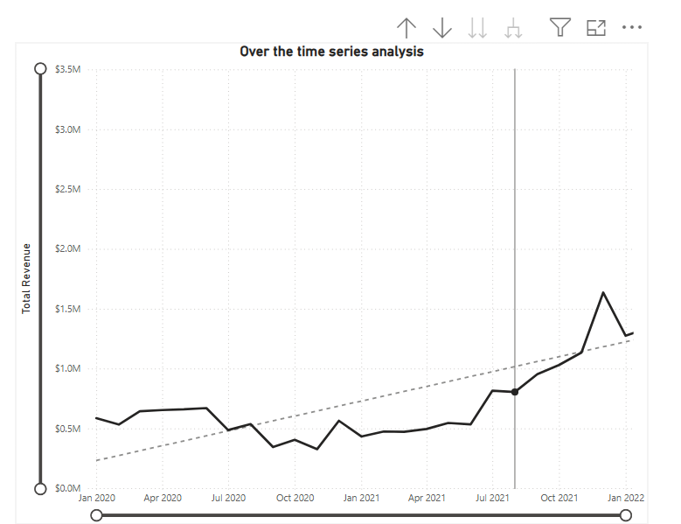
This line chart tracks total revenue over time on a monthly or quarterly basis.
There is clear declining trend in revenue from mid 2020 to early 2022
The chart also includes a dotted trendline ,which confirms the downword movement.

Slide 16
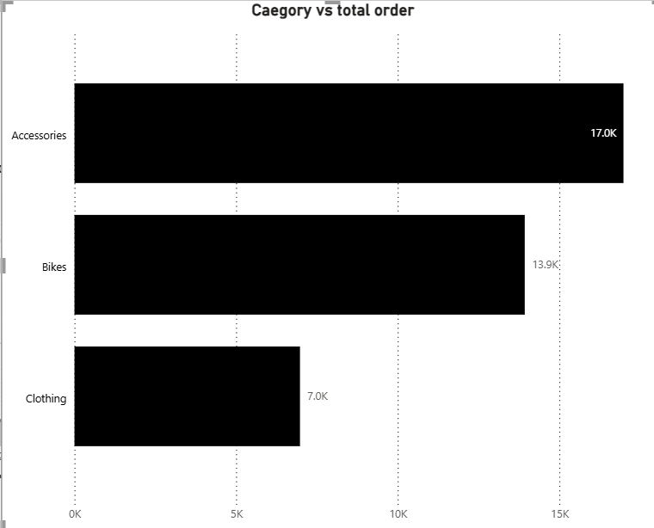
The Category vs total orders chart shows that accessories dominate the product orders with over 17,000 units, followed by Bikes and then clothing . This indicates strong consumer interest in accessory products, potentially due to lower pricing or higher utility.
Accessories have the highest number of orders among all categories contributing the most to total sales volume.
Bikes are the second most ordered category
Clothing has the lowest order volume under 7K orders.

Slide 17
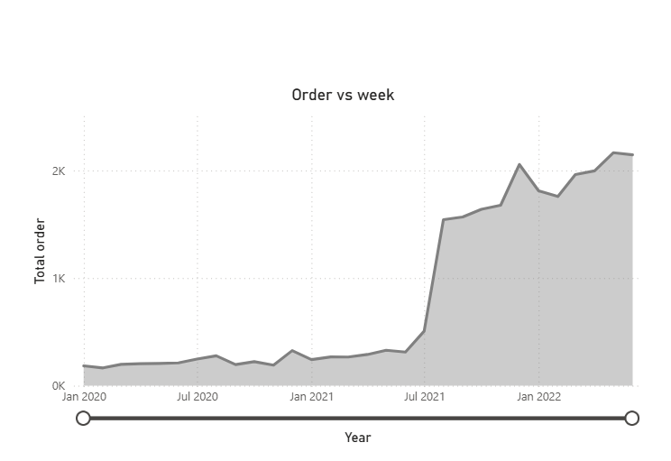
This chart displays the weekly total number of orders over a 2-year period.
The area is shaded ,showing order volume intensity.
The trend starts strong in early 2020 then shows a steady decline through 2021 and into 2022.

Slide 18
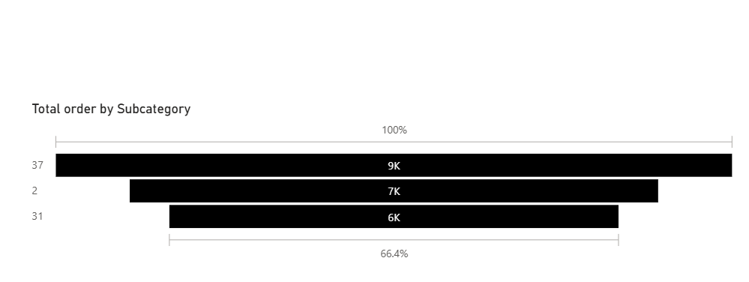
This chart visualizes order volume for different sub
categories(e.g helmets, tires, water bottles etc..)
The longest bar represents the subcategory with the highest total orders, possibly making up more than 30% of total subcategory sales.
The shortest bar indicates the least ordered subcategory

Slide 19
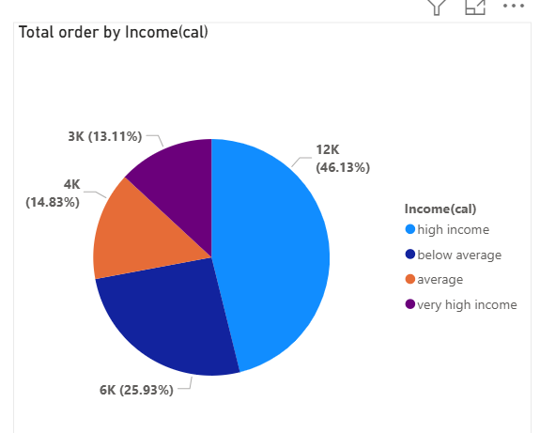
The pie chart shows that the majority of orders come from high –income customers (46.13%), followes by below-average income groups(25.93%). This indicates a wide customer base ranging from price sensitive buyers to premium shoppers.

Slide 20
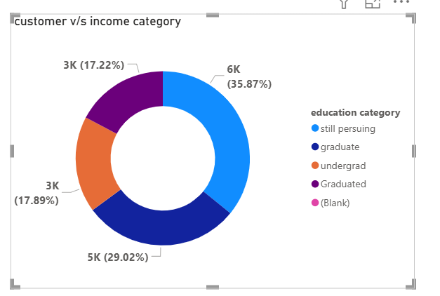
The Donut chart of customer vs Education category shows that the business caters mostly to graduate (35.87%) and students currently pursuing education(29.02%). This indicates a strong customer base among educated and younger audiences.

Slide 21
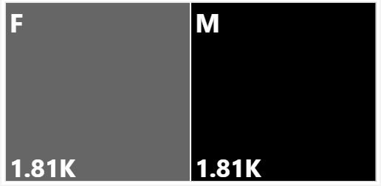
The chart shows that both male and female customers have an equal share in total returns, each contributing 1.81K. This suggests gender does not significantly influence return behavior. Therefore, efforts to reduce return rates should
focus on product quality, fit, or delivery experience, rather than demographic-specific adjustments.

Slide 22
Key Insights(Product Target & Performance Dashboard)
Revenue performance is strong, very close to the goal
Orders and Profit are slightly below target, including the need to: Increase sales volume
Improve profit margins or reduce costs
Top Product highlight :
Water bottle – 30 oz –One of the most frequently
orderd items(high volume).
The “Orders vs week ” chart shows
Orders peaked in early 2020
Consistent decline through 2021-2022
A small recovery spike mid - 2021

Slide 23
Key Insights (Customer demographics dashboard)
High income customers account for the largest share of total orders(46.13%, 12K)
Below Average income group also contribute significantly (25.93%,6K orders)
Very high Income group contributes the least(13.11%).
High income individuals are your most active buyers, but there’s untapped potential in very high income and average income groups.
Graduate make up the largest segment (35.87%).
followed by those still pursuing education(29.02%)
undergrads and graduated are equally distributed(17% each)

Slide 24
Business Values
Identifies key customer segments based on income, education, and gender
Supports targated marketing , like student offers or premium product promotions
Highlights best selling products Categories (e.g, Accessories) for inventory and sales focus.
Ensures inclusive branding by showing balance male female customer base.
Improves decision making with data on customer behavior and order patterens.

Slide 25
Conclusion
The customer demographics dashboard provides valuable insights into who the customers are, how they behave , and what they purchase. By analyzing income levels, education backgrounds, gender distribution and order patterens , the business gains a deeper understanding of its target audience.
These insights support smarter marketing , better product positioning, and more personalized experience. The dashboard helps the business make data driven decisions that increase engagement , boost sales, and strengthen long term customer relationships.

Slide 26
Thank You☺

